Slide 1
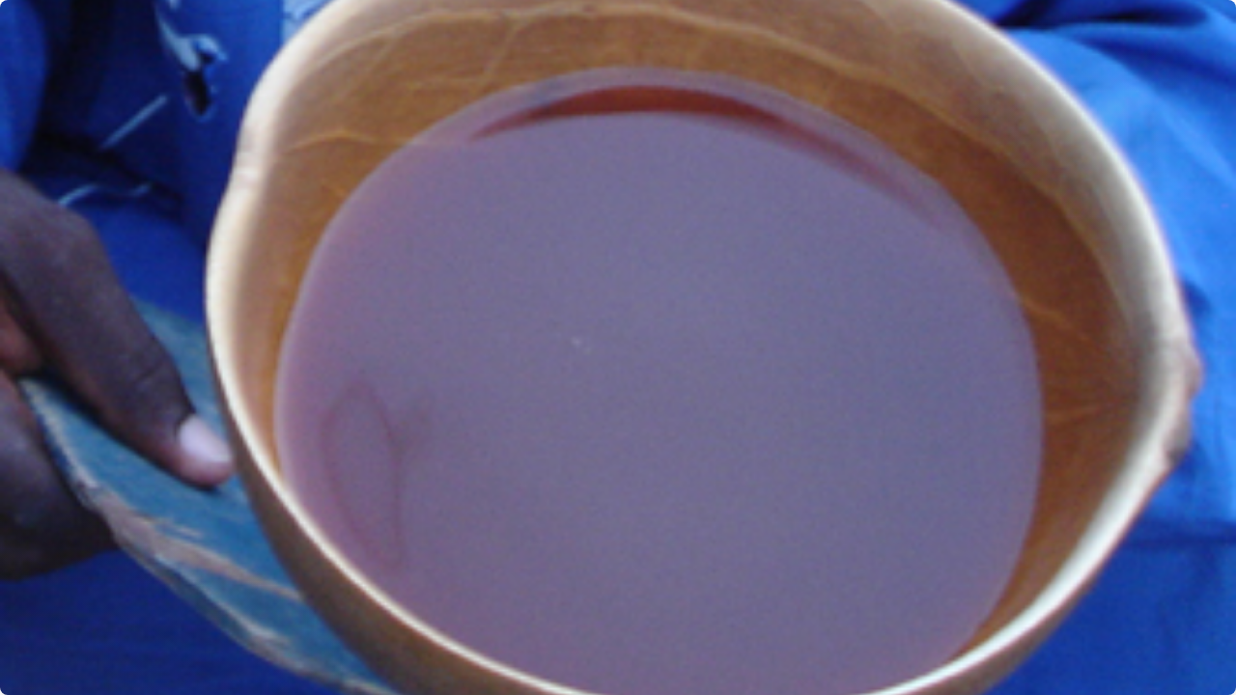

Effect of lemongrass (cymbopogon citratus) and ginger extract incorporation on the microbiological stability and shelf life of pito
Enhancing Microbiological Stability & Shelf Life
Research Proposal | December 14, 2025

Slide 2

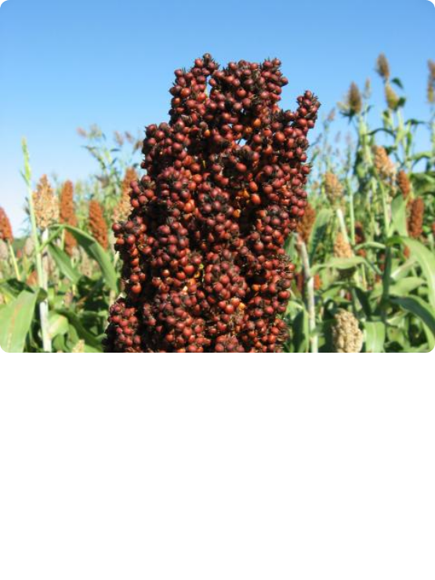

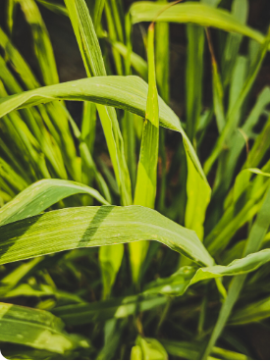
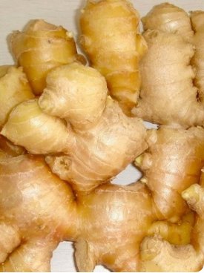
Introduction: The Pito Challenge
Pito is a fermented alcoholic beverage made from malted sorghum (Sorghum bicolor). Despite its popularity, Pito suffers from rapid spoilage, typically within a 2 to 3 days interval.
Lemongrass: Contains essential oils rich in Citral (70-80%).
Ginger: Renowned for bioactive compounds: Gingerols, Shogaols, and Paradols.

Slide 3









Research Objectives
General Objective
To investigate the effect of Lemongrass and Ginger extract incorporation on the microbiological stability and shelf life extension of pito.
Specific Objectives
Antimicrobial
Sensory
Physicochemical
Nutritional
Assess efficacy against spoilage organisms (Lactobacillus spp. & Aspergillus spp.).
Evaluate the sensory characteristics of the formulated beverage.
Measure the major impact on physicochemical properties.
Determine added nutritional components through proximate analysis.

Slide 4



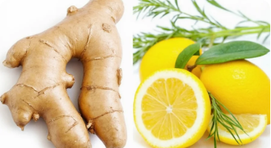
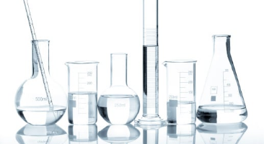

Materials
Raw Materials
Reagents
Equipment
•
Malted Sorghum grains
•
Ethanol, Distilled water
•
Incubator, Autoclave
•
Fresh Lemongrass leaves
•
Nutrient Agar
•
pH Meter, Refractometer
•
Fresh Ginger rhizomes
•
PDA, MRS Agar
•
Spectrophotometer

Slide 5
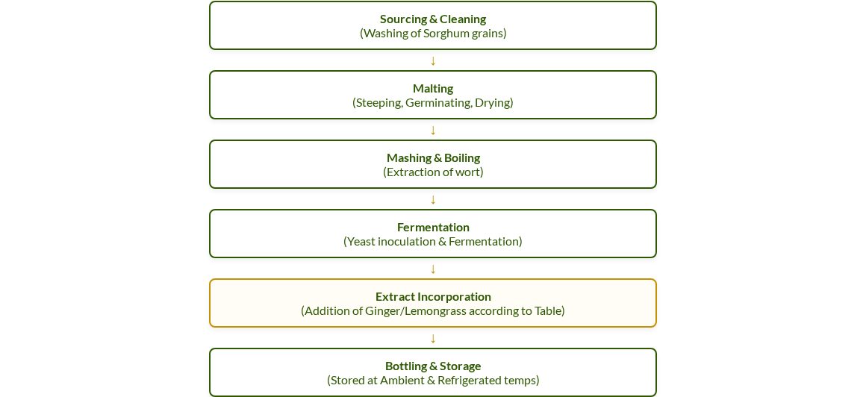
Methodology: Production Flow

Slide 6
Formulation Table
Code | Pito (mL) | Lemongrass (mL) | Ginger (mL) | Description / Comment
T1 | 100.0 | 0.0 | 0.0 | Control (Pure Pito)
T2 | 90.0 | 10.0 | 0.0 | Lemongrass Alone
T3 | 90.0 | 7.5 | 2.5 | High Lemongrass Ratio
T4 | 90.0 | 5.0 | 5.0 | Moderate Mix (1:1 Ratio)
T5 | 90.0 | 2.5 | 7.5 | High Ginger Ratio
T6 | 90.0 | 0.0 | 10.0 | Ginger Alone
* T1 is the Control variable containing 100% Pito base with no extracts.

Slide 7








Analysis Plan
Microbiological
Sensory
Physicochemical
Proximate
Inhibition Zone (Lactobacillus/Aspergillus) & Total Viable Count.
50 Panelists (9-point Hedonic Scale). Aroma, Taste, Mouthfeel, Overall.
Daily monitoring of pH, TTA, Alcohol % v/v, and Turbidity.
Crude protein, moisture, ash content, and carbohydrate profile.

Slide 8

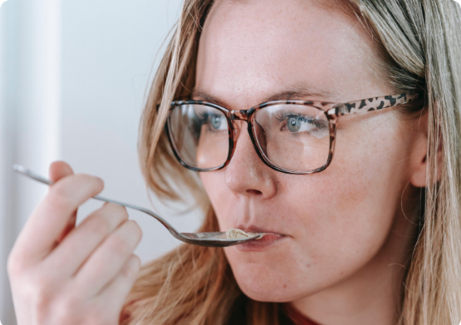
Expected Outcomes
Antimicrobial Efficacy Significant inhibition of Lactobacillus and Aspergillus, extending stability beyond 2-3 days.
Sensory Acceptance Identification of an optimal ratio (e.g., T4 or T5) that masks spoilage without overpowering taste.
Physicochemical Stability Maintenance of stable pH and acidity levels, delaying the souring process.

Slide 9
Project Timeline (12 Weeks)
Weeks 1-2
Weeks 3-4
Weeks 5-8
Weeks 9-10
Weeks 11-12
Sourcing & Extract Prep
Production & Formulation
Lab Analysis
Sensory Evaluation
Analysis & Submission

Slide 10
References
Adadi, P., & Kanwugu, O. N. (2020). Pito fermentation: An indigenous technology in Northern Ghana. Journal of Ethnic Foods, 7(1), 1–10.
Avicor, S. W., et al. (2016). Characterization of the microbial community in pito wort. African Journal of Microbiology Research, 10(20), 690–697.
He, Y., et al. (2023). Antibacterial activity of ginger essential oil against Listeria monocytogenes. Food Control, 145, 109462.
Snyder, A. B., et al. (2024). Antimicrobial efficacy of lemon grass oil in apple cider. Journal of Food Protection, 87(3), 100123.

